Slide 1
Link Prediction
-20pt14 KrishnaShree
-20pt20 Nimisha
-20pt31 Sindhu Sundar

Slide 2
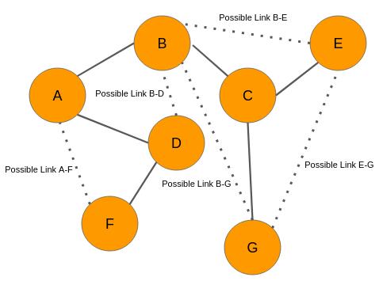
Introduction
In network theory, link prediction is the problem of predicting the existence of a link between two entities in a network.

Slide 3
Problem Definition
Consider a network G=(V,E), where
V represents the entity nodes in the network.
E ⊆ |V|×|V| represents the set of "true" links across entities in the network. (observed links)
The goal of link prediction is to identify the unobserved true links.

Slide 4
Applications of Link Prediction
Link prediction is used in social networks to suggest friends to users.
It is also used to predict criminal associations.
In biology, link prediction has been used to predict interactions between proteins in protein-protein interaction networks.
Link prediction has also been used to infer interactions between drugs and targets.
It is also used in collaboration prediction in scientific co-authorship networks.

Slide 5
Link Prediction Metrics
The link prediction method, in principle, provides a similarity score for each non-existing link and for most methods, a higher score means higher likelihood that the link will appear in the future. Final prediction is done by ordering this score list and selecting top links with the highest score.
Common Neighbours (CN)
Salton index (Cosine similarity)
Jaccard index
Katz global path indicator
are a few metrics used for link prediction.

Slide 6
Common Neighbours (CNN)
Two nodes are more likely to be connected if they have more common neighbours. If Γ(i) represents the vector associated with node i that includes the neighbours of node i, we express this relationship as:
S_{ij} = |Γ(i)∩Γ(j)|

Slide 7
Jaccard index
This method is the proportion of common neighbours between two nodes i and j in the total number of neighbours:
S_{ij} = (|Γ(i)∩Γ(j)|) / (|Γ(i)∪Γ(j)|)

